Slide 1
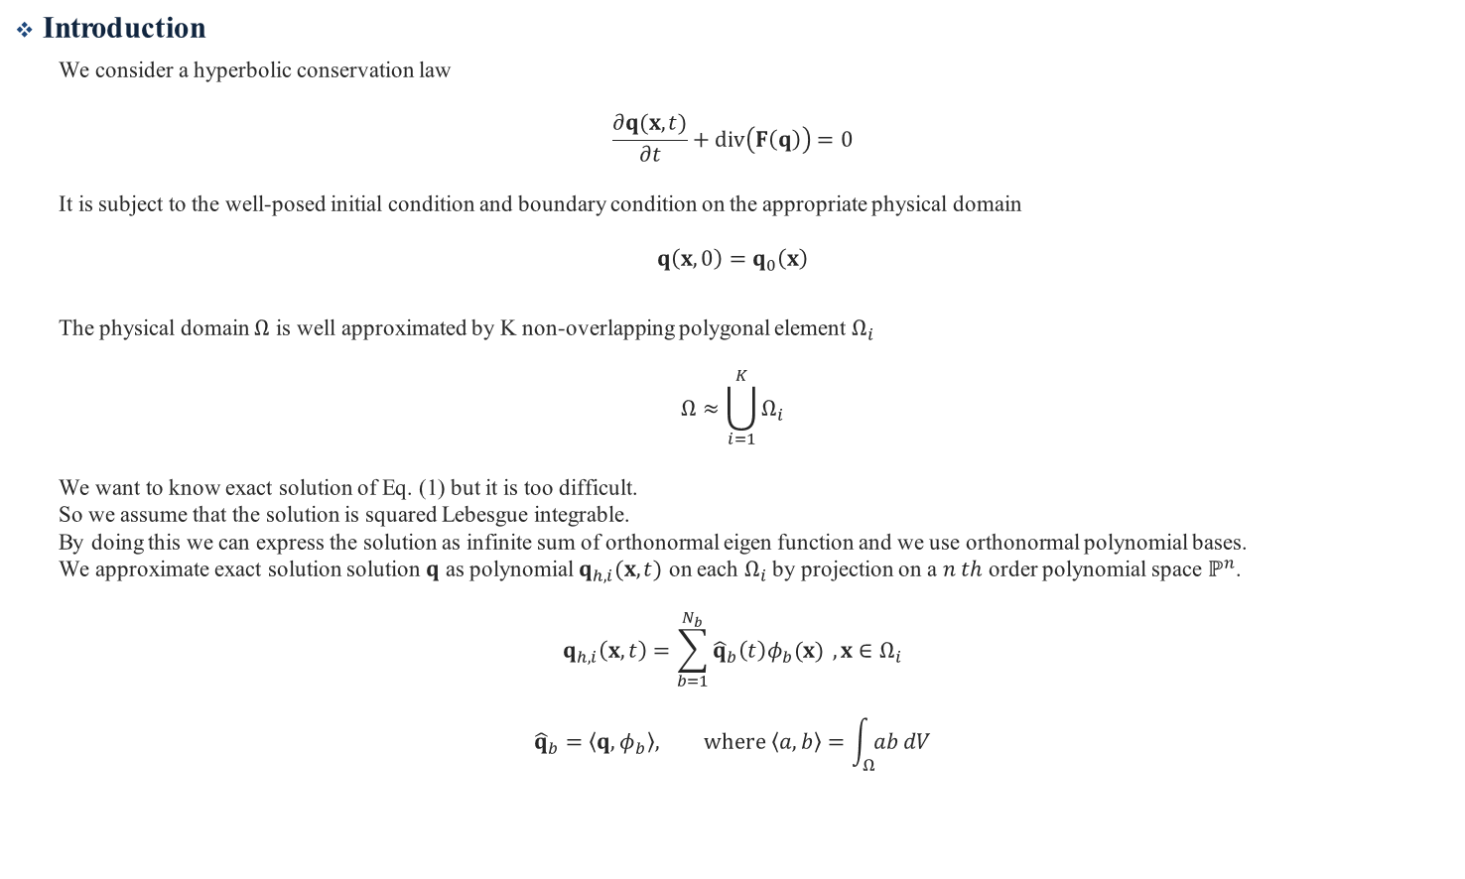
Discontinuous Galerkin Method
Introduction
We consider a hyperbolic conservation law
$$\frac{∂q(x,t)}{∂t}+div\left(F\left(q\right)\right)=0$$
It is subject to the well-posed initial condition and boundary condition on the appropriate physical domain
$$q\left(x,0\right)=q_{0}\left(x\right)$$
The physical domain $Ω$ is well approximated by K non-overlapping polygonal element $Ω_{i}$
$$Ω≈\bigcup_{i=1}^{K}{Ω_{i}}$$
We want to know exact solution of Eq. (1) but it is too difficult.
So we assume that the solution is squared Lebesgue integrable.
By doing this we can express the solution as infinite sum of orthonormal eigen function and we use orthonormal polynomial bases.
We approximate exact solution solution $q$ as polynomial $q_{h,i}(x,t)$ on each $Ω_{i}$ by projection on a $n th$ order polynomial space $ℙ^{n}$.
$$q_{h,i}\left(x,t\right)=\sum_{b=1}^{N_{b}}{{\hat{q}}_{b}\left(t\right)φ_{b}(x)} , x∈Ω_{i}$$
$${\hat{q}}_{b}=\left\langle q,φ_{b}\right\rangle , where \left\langle a,b\right\rangle =\int_{Ω}{ab}dV$$

Slide 2
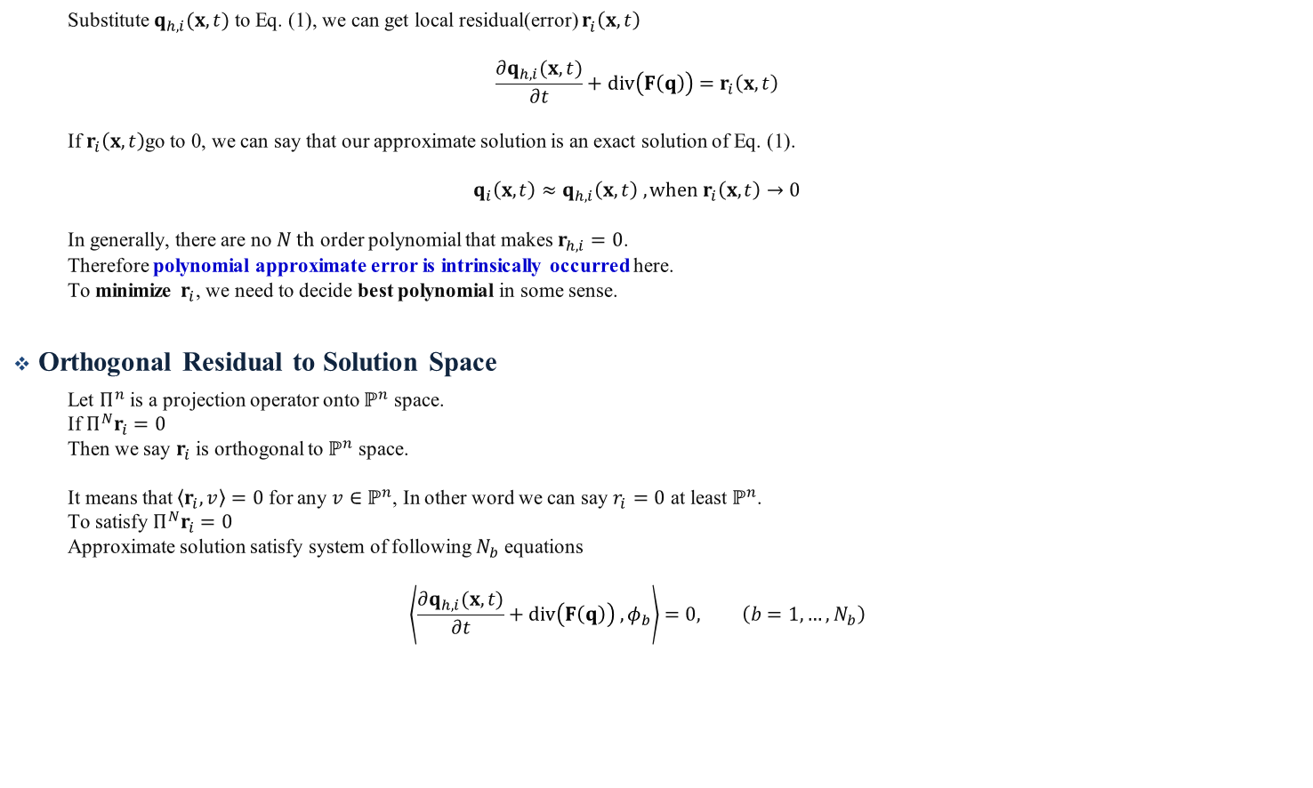
Discontinuous Galerkin Method
Substitute $q_{h,i}(x,t)$ to Eq. (1), we can get local residual(error) $r_{i}^{ }\left(x,t\right)$
$$\frac{∂q_{h,i}(x,t)}{∂t}+div\left(F\left(q\right)\right)=r_{i}\left(x,t\right)$$
If $r_{i}\left(x,t\right)$go to 0, we can say that our approximate solution is an exact solution of Eq. (1).
$$q_{i}\left(x,t\right)≈q_{h,i}\left(x,t\right) , when r_{i}\left(x,t\right)→0$$
In generally, there are no $N th$ order polynomial that makes $r_{h,i}=0$.
Therefore polynomial approximate error is intrinsically occurred here.
To minimize $r_{i}$, we need to decide best polynomial in some sense.
Orthogonal Residual to Solution Space
Let $Π^{n}$ is a projection operator onto $ℙ^{n}$ space.
If $Π^{N}r_{i}=0$
Then we say $r_{i}$ is orthogonal to $ℙ^{n}$ space.
It means that $\left\langle r_{i},v\right\rangle =0$ for any $v∈ℙ^{n}$, In other word we can say $r_{i}=0$ at least $ℙ^{n}$.
To satisfy $Π^{N}r_{i}=0$
Approximate solution satisfy system of following $N_{b}$ equations
$$\left\langle \frac{∂q_{h,i}(x,t)}{∂t}+div\left(F\left(q\right)\right) , φ_{b}\right\rangle =0, \left(b=1,…,N_{b}\right)$$

Slide 3

DG weak formulation
Above equation can be rewrite as
$$\int_{Ω_{i}}{\frac{∂}{∂t}\left(q_{h,i}\left(x,t\right)\right)φ_{b}(x)dV}=−\int_{Ω_{i}}{div\left(F\left(q_{h,i}\left(x,t\right)\right)\right)φ_{b}\left(x\right)dV}, \left(b=1,…,N_{b}\right)$$
Using divergence theorem
$$\frac{∂}{∂t}\int_{Ω_{i}}{q_{h,i}\left(x,t\right)φ_{b}(x)dV}=\int_{Ω_{i}}{F\left(q_{h,i}\left(x,t\right)\right)grad\left(φ_{b}\left(x\right)\right)dV}−\int_{{∂Ω}_{i}}{F\left(q_{h,i}\left(x,t\right)\right)φ_{b}\left(x\right)ndS}, \left(b=1,…,N_{b}\right)$$
We call it DG weak formulation.

Slide 4

DG Weak Formulation Calculation
DG weak formulation is as follow
$$\frac{∂}{∂t}\int_{Ω_{i}}{q_{h,i}φ_{b}(x)dV}=\int_{Ω_{i}}{F\left(q_{h,i}\left(x,t\right)\right)grad\left(φ_{b}\left(x\right)\right)dV}−\int_{{∂Ω}_{i}}{F\left(q_{h,i}\left(x,t\right)\right)φ_{b}\left(x\right)∙ndS}, \left(b=1,…,N_{b}\right)$$
LHS
$$\frac{∂}{∂t}\int_{Ω_{i}}{q_{h,i}φ_{b}\left(x\right)dV}=\frac{∂}{∂t}\int_{Ω_{i}}{\left(\sum_{l=1}^{N}{{\hat{q}}_{l}\left(t\right)φ_{l}\left(x\right)}\right)φ_{b}\left(x\right)dV}=\frac{d}{dt}{\hat{q}}_{b}\left(t\right), \left(b=1,…,N_{b}\right)$$
This system of LHS can be represented
$$\left[\begin{matrix}\frac{d}{dt}{\hat{q}}_{1}\left(t\right) & ⋯ & \frac{d}{dt}{\hat{q}}_{N_{b}}\left(t\right)\end{matrix}\right]$$
$$[E×B]$$

Slide 5

Volume integral term of RHS
$$\int_{Ω_{i}}{F\left(q_{h,i}\left(x,t\right)\right)grad\left(φ_{b}\left(x\right)\right) }dV=\sum_{q}{F\left(q_{h,i}\left(x_{q},t\right)\right)grad\left(φ_{b}\left(x_{q}\right)\right)w_{q}}=F_{q}𝔀_{qb}^{ }, \left(b=1,…,N_{b}\right)$$
Where
$$F_{q}=\left[\begin{matrix}F\left(q_{h,i}\left(x_{1},t\right)\right) & ⋯ & F\left(q_{h,i}\left(x_{q},t\right)\right)\end{matrix}\right]$$
$$\left[E×(V×QP)\right]$$
$$𝔀_{qb}^{ }=\left[\begin{matrix}\left[grad\left(φ_{1}\left(x_{1}\right)\right)w_{1}\right] & ⋯ & \left[grad\left(φ_{b}\left(x_{1}\right)\right)w_{1}\right] \\ ⋮ & ⋱ & ⋮ \\ \left[grad\left(φ_{1}\left(x_{q}\right)\right)w_{q}\right] & ⋯ & \left[grad\left(φ_{b}\left(x_{q}\right)\right)w_{q}\right]\end{matrix}\right]$$
$$\left[\left(QP×V\right)×B\right]$$
$$\left[\begin{matrix}F_{q}\left(q_{h,i}\left(x_{1},t\right)\right) & ⋯ & F_{q}\left(q_{h,i}\left(x_{q},t\right)\right)\end{matrix}\right] \left[\begin{matrix}\left[grad\left(φ_{1}\left(x_{1}\right)\right)w_{1}\right] & ⋯ & \left[grad\left(φ_{b}\left(x_{1}\right)\right)w_{1}\right] \\ ⋮ & ⋱ & ⋮ \\ \left[grad\left(φ_{1}\left(x_{q}\right)\right)w_{q}\right] & ⋯ & \left[grad\left(φ_{b}\left(x_{q}\right)\right)w_{q}\right]\end{matrix}\right]$$
$$\left[E×(V×QP)\right]\left[\left(QP×V\right)×B\right]⇒[E×B]$$
Here $F$ is flux matrix, $F_{q}$ is flux quadrature tensor and $𝔀_{qb}^{ }$is quadrature gradient basis.

Slide 6

Surface integral term of RHS
$$\int_{{∂Ω}_{i}}{F\left(q_{h,i}\left(x,t\right)\right)φ_{b}\left(x\right)∙n}dS≈\int_{{∂Ω}_{i}}{\tilde{f}\left(q_{h,i}^{−}\left(x,t\right),q_{h,i}^{+}\left(x,t\right),n\right)φ_{b}\left(x\right)}dS=\sum_{j}{{\sum_{q}{\tilde{f_{j}}}\left(x,t\right)φ}_{b}\left(x_{q}\right)w_{q}}=\sum_{j}{{\tilde{F}}_{jq}𝔀_{qb}^{ }}, \left(b=1,…,N_{b}\right)$$
Where
$${\tilde{F}}_{jq}=\left[\begin{matrix}\tilde{f_{j}}\left(x_{1},t\right) & ⋯ & \tilde{f_{j}}\left(x_{q},t\right)\end{matrix}\right]$$
$$\left[E×QP\right]$$
$$𝔀_{qb}^{ }=\left[\begin{matrix}φ_{1}\left(x_{1}\right)w_{1} & ⋯ & φ_{b}\left(x_{1}\right)w_{1} \\ ⋮ & ⋱ & ⋮ \\ φ_{1}\left(x_{q}\right)w_{q} & ⋯ & φ_{b}\left(x_{q}\right)w_{q}\end{matrix}\right]$$
$$\left[QP×B\right]$$
$$\sum_{j}{\left[\begin{matrix}\tilde{f_{j}}\left(x_{1},t\right) & ⋯ & \tilde{f_{j}}\left(x_{q},t\right)\end{matrix}\right]\left[\begin{matrix}φ_{1}\left(x_{1}\right)w_{1} & ⋯ & φ_{b}\left(x_{1}\right)w_{1} \\ ⋮ & ⋱ & ⋮ \\ φ_{1}\left(x_{q}\right)w_{q} & ⋯ & φ_{b}\left(x_{q}\right)w_{q}\end{matrix}\right]}$$
$$\left[E×QP\right]\left[QP×B\right]⇒[E×B]$$
Here $\tilde{f_{j}}$ is numerical flux vector for $j th$ face, ${\tilde{F}}_{jq}$is numerical flux quadrature matrix and $𝔀_{qb}^{ }$ is quadrature basis.

Slide 7
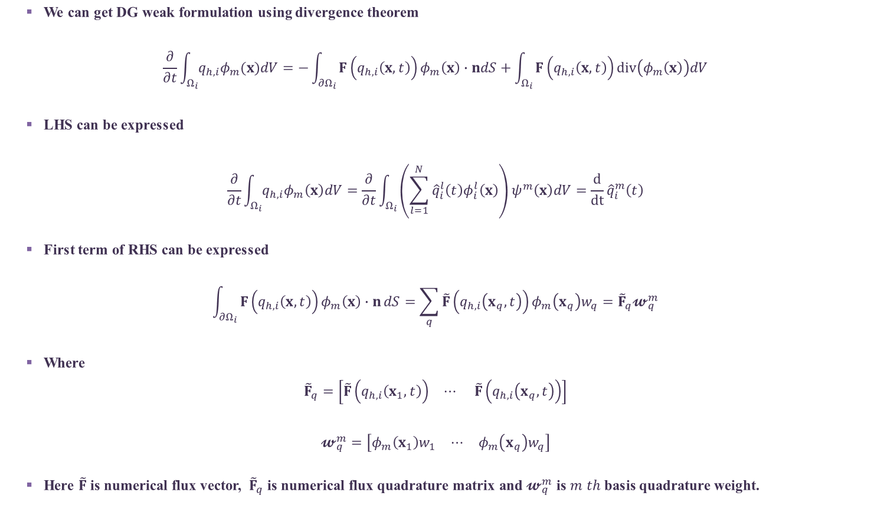
We can get DG weak formulation using divergence theorem
$$\frac{∂}{∂t}\int_{Ω_{i}}{q_{h,i}φ_{m}(x)dV}=−\int_{{∂Ω}_{i}}{F\left(q_{h,i}\left(x,t\right)\right)φ_{m}\left(x\right)∙ndS}+\int_{Ω_{i}}{F\left(q_{h,i}\left(x,t\right)\right)div\left(φ_{m}\left(x\right)\right)dV}$$
LHS can be expressed
$$\frac{∂}{∂t}\int_{Ω_{i}}{q_{h,i}φ_{m}\left(x\right)dV}=\frac{∂}{∂t}\int_{Ω_{i}}{\left(\sum_{l=1}^{N}{{\hat{q}}_{i}^{l}\left(t\right)φ_{i}^{l}\left(x\right)}\right)ψ^{m}\left(x\right)dV}=\frac{d}{dt}{\hat{q}}_{i}^{m}\left(t\right)$$
First term of RHS can be expressed
$$\int_{{∂Ω}_{i}}{F\left(q_{h,i}\left(x,t\right)\right)φ_{m}\left(x\right)∙n}dS=\sum_{q}{\tilde{F}\left(q_{h,i}\left(x_{q},t\right)\right)}φ_{m}\left(x_{q}\right)w_{q}={\tilde{F}}_{q}𝔀_{q}^{m}$$
Where
$${\tilde{F}}_{q}=\left[\begin{matrix}\tilde{F}\left(q_{h,i}\left(x_{1},t\right)\right) & ⋯ & \tilde{F}\left(q_{h,i}\left(x_{q},t\right)\right)\end{matrix}\right]$$
$$𝔀_{q}^{m}=\left[\begin{matrix}φ_{m}\left(x_{1}\right)w_{1} & ⋯ & φ_{m}\left(x_{q}\right)w_{q}\end{matrix}\right]$$
Here $\tilde{F}$ is numerical flux vector, ${\tilde{F}}_{q}$ is numerical flux quadrature matrix and $𝔀_{q}^{m}$ is $m th$ basis quadrature weight.

Slide 8
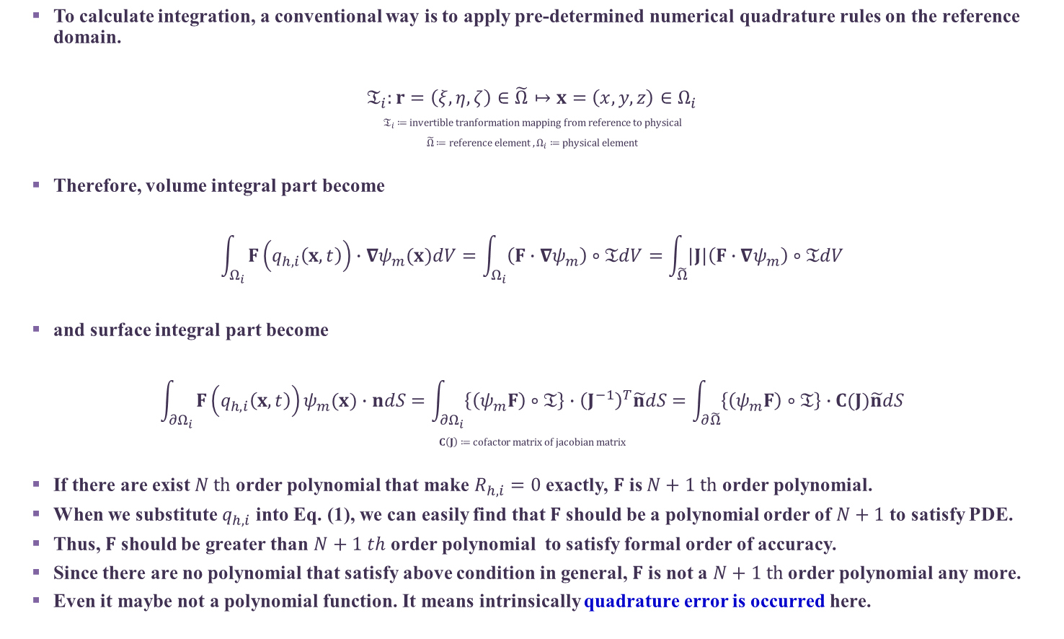
Modal Discontinuous Galerkin Method
To calculate integration, a conventional way is to apply pre-determined numerical quadrature rules on the reference domain.
$$𝔗_{i}:r=\left(ξ,η,ζ\right)∈\tilde{Ω}↦x=\left(x,y,z\right)∈Ω_{i}$$
$$𝔗_{i}≔invertible tranformation mapping from reference to physical$$
$$\tilde{Ω}≔reference element , Ω_{i}≔physical element$$
Therefore, volume integral part become
$$\int_{Ω_{i}}{F\left(q_{h,i}\left(x,t\right)\right)∙∇ψ_{m}(x)dV}=\int_{Ω_{i}}{\left(F∙∇ψ_{m}\right)∘𝔗dV}=\int_{\tilde{Ω}}{|J|\left(F∙∇ψ_{m}\right)∘𝔗dV}$$
and surface integral part become
$$\int_{{∂Ω}_{i}}{F\left(q_{h,i}\left(x,t\right)\right)ψ_{m}(x)∙ndS}=\int_{{∂Ω}_{i}}{\left\{\left(ψ_{m}F\right)∘𝔗\right\}∙{\left(J^{−1}\right)}^{T}\tilde{n}dS}=\int_{∂\tilde{Ω}}{\left\{\left(ψ_{m}F\right)∘𝔗\right\}∙C(J)\tilde{n}dS}$$
$$C\left(J\right)≔cofactor matrix of jacobian matrix$$
If there are exist $N th$ order polynomial that make $R_{h,i}=0$ exactly, $F$ is $N+1 th$ order polynomial.
When we substitute $q_{h,i}$ into Eq. (1), we can easily find that $F$ should be a polynomial order of $N+1$ to satisfy PDE.
Thus, $F$ should be greater than $N+1 th$ order polynomial to satisfy formal order of accuracy.
Since there are no polynomial that satisfy above condition in general, $F$ is not a $N+1 th$ order polynomial any more.
Even it maybe not a polynomial function. It means intrinsically quadrature error is occurred here.

Slide 9

Modal Discontinuous Galerkin Method
When we approximate physical flux function as $N+1 th$ order polynomial.
$$\sum_{i}{ω_{i}\left(F⋅∇ψ\right)\left(x_{i}\right)}=\int{{\left(F⋅∇ψ\right)}_{h}(x)}dV=\int{{\left\{(F−F^{high})⋅∇ψ\right\}}_{h}(x)}dV+\int{{\left(F^{high}⋅∇ψ\right)}_{h}\left(x\right)}dV$$
$$⇒\int{\left\{\left(F−F^{high}\right)⋅∇ψ\right\}(x)}dV+\int{{\left(F_{ }^{high}⋅∇ψ\right)}_{h}(x)}dV=\int{F⋅∇ψ(x)}dV+\int{\left\{{\left(F_{ }^{high}⋅∇ψ\right)}_{h} −F^{high}⋅∇ψ\right\}(x)}dV$$
Here ${\left(∙\right)}_{h}$ means the $2N+1 th$order polynomial approximation of $(∙)$.
After quadrature we have additional error term$\int{\left\{{\left(F_{ }^{high}⋅∇ψ\right)}_{h} −F^{high}⋅∇ψ\right\}(x)}dV$ compared with original equation.

Slide 10

Appendix 1 Find Initial Coefficients
We approximate solution with physical orthonormal basis function $ψ$
$$q\left(x,t\right)≈q_{h,i}\left(x,t\right)=\sum_{m=1}^{N}{{\hat{q}}_{i}^{m}\left(t\right)}ψ_{i}^{m}(x), x∈Ω_{i}$$
$$⇒q\left(x,t\right)ψ_{i}^{l}\left(x\right)≈\sum_{m=1}^{N}{{\hat{q}}_{i}^{m}\left(t\right)ψ_{i}^{m}\left(x\right)}ψ_{i}^{l}\left(x\right)$$
$$⇒\int_{Ω_{i}}{q\left(x,t\right)ψ_{i}^{l}(x)}dV≈\sum_{m=1}^{N}{{\hat{q}}_{i}^{m}\left(t\right)}\int_{Ω_{i}}{ψ_{i}^{m}(x)ψ_{i}^{l}(x)}dV$$
$$⇒\int_{Ω_{i}}{q\left(x,t\right)ψ_{i}^{l}(x)}dV≈{\hat{q}}_{i}^{l}\left(t\right)$$
$$⇒\int_{\tilde{Ω}}{|J|\left(q\left(x,t\right)ψ_{i}^{l}\left(x\right)\right)∘𝔗_{i}}dV≈{\hat{q}}_{i}^{l}\left(t\right)$$
What integration order should we choose? , is it make any difference ?
In Team code $\left|J\right|×2×order$
$$⇒\sum_{q}{{\left[\left|J\right|\left(q\left(x,t\right)ψ_{i}^{l}\left(x\right)\right)∘𝔗_{i}\right]}_{q}w_{q}}≈{\hat{q}}_{i}^{l}\left(t\right)$$

Slide 11

Appendix 1 Find Initial Coefficients
We approximate solution with reference orthonormal basis function $ψ$
$q\left(x,t\right)=𝔗_{i}\left(q\left(r,t\right)\right),x∈Ω_{i}$
$q\left(r,t\right)≈q_{h,i}\left(r,t\right)=\sum_{m=1}^{N}{{\hat{q}}_{i}^{m}\left(t\right)}ψ_{i}^{m}\left(r\right)$
$⇒q\left(r,t\right)ψ_{i}^{l}\left(r\right)≈\sum_{m=1}^{N}{{\hat{q}}_{i}^{m}\left(t\right)ψ_{i}^{m}\left(r\right)}ψ_{i}^{l}\left(r\right)$
$⇒\int_{\tilde{Ω}}{q\left(r,t\right)ψ_{i}^{l}(r)}dV≈\sum_{m=1}^{N}{{\hat{q}}_{i}^{m}\left(t\right)}\int_{\tilde{Ω}}{ψ_{i}^{m}(r)ψ_{i}^{l}(r)}dV$
$⇒\int_{\tilde{Ω}}{q\left(r,t\right)ψ_{i}^{l}(r)}dV≈{\hat{q}}_{i}^{l}\left(t\right)$
What integration order should we choose? , is it make any difference ?
$⇒\sum_{q}{{\left[q\left(r,t\right)ψ_{i}^{l}(r)\right]}_{q}w_{q}}≈{\hat{q}}_{i}^{l}\left(t\right)$

Slide 12

Appendix 1 Find Initial Coefficients
We approximate solution with physical basis function $ψ$
$q\left(x,t\right)≈q_{h,i}\left(x,t\right)=\sum_{m=1}^{N}{{\hat{q}}_{i}^{m}\left(t\right)}ψ_{i}^{m}(x), x∈Ω_{i}$
$⇒q\left(x,t\right)ψ_{i}^{l}\left(x\right)≈\sum_{m=1}^{N}{{\hat{q}}_{i}^{m}\left(t\right)ψ_{i}^{m}\left(x\right)}ψ_{i}^{l}\left(x\right)$
$⇒\int_{Ω_{i}}{q\left(x,t\right)ψ_{i}^{l}(x)}dV≈\sum_{m=1}^{N}{{\hat{q}}_{i}^{m}\left(t\right)}\int_{Ω_{i}}{ψ_{i}^{m}(x)ψ_{i}^{l}(x)}dV$
$⇒\int_{\tilde{Ω}}{|J|\left(q\left(x,t\right)ψ_{i}^{l}\left(x\right)\right)∘𝔗_{i}}dV≈\sum_{m=1}^{N}{{\hat{q}}_{i}^{m}\left(t\right)}\int_{\tilde{Ω}}{|J|\left(ψ_{i}^{m}(x)ψ_{i}^{l}(x)\right)∘𝔗_{i}}dV$
When $\left|J\right|=const$, if we define $ψ_{i}^{m}(x)$ $∘𝔗_{i}$ as known reference basis function ${\tilde{ψ}}^{m}(r)$
$⇒\int_{\tilde{Ω}}{\left(q\left(x,t\right)ψ_{i}^{l}\left(x\right)\right)∘𝔗_{i}}dV≈{\hat{q}}_{i}^{l}\left(t\right)$

Slide 13
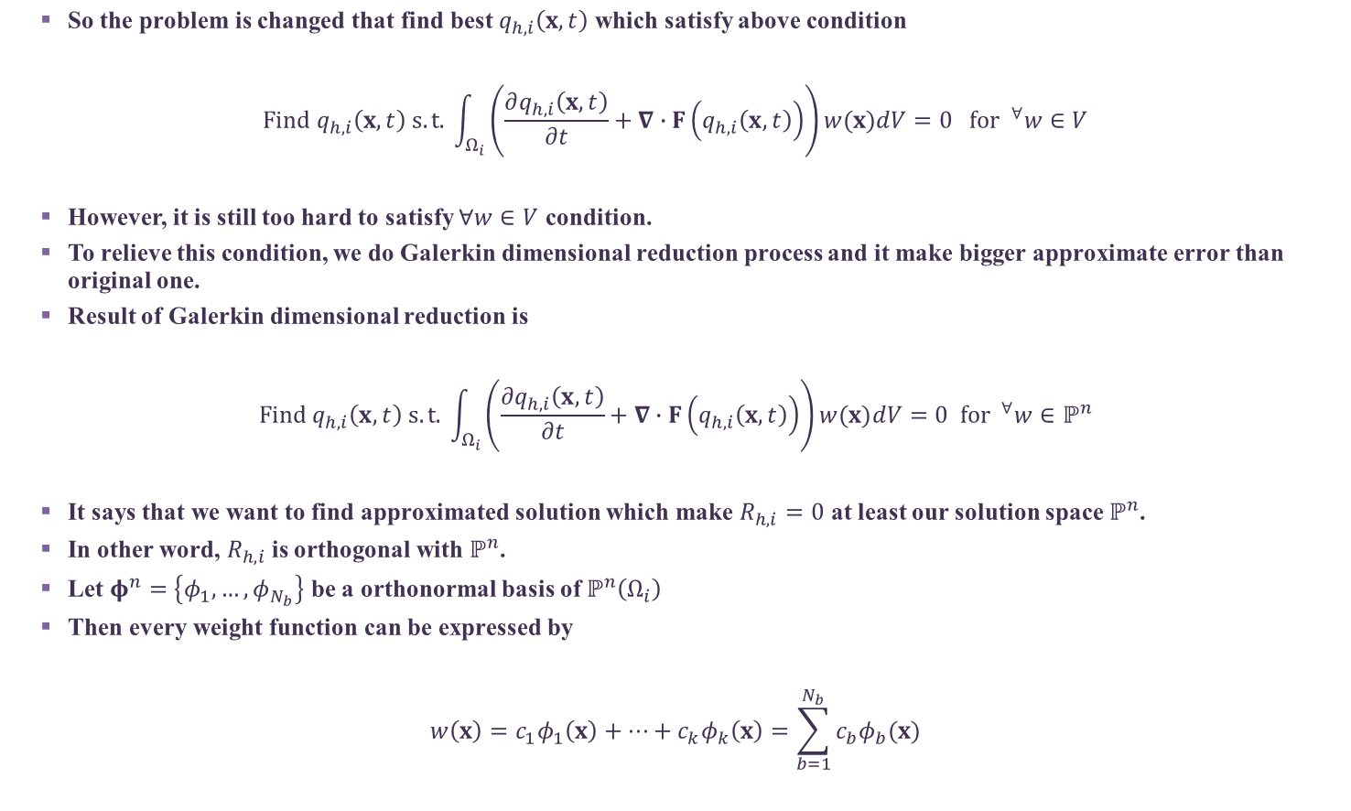
Modal Discontinuous Galerkin Method
So the problem is changed that find best $q_{h,i}\left(x,t\right)$ which satisfy above condition
$$Find q_{h,i}\left(x,t\right) s.t. \int_{Ω_{i}}{\left(\frac{∂q_{h,i}\left(x,t\right)}{∂t}+∇∙F\left(q_{h,i}\left(x,t\right)\right)\right)w(x)dV}=0 for ^{∀}w∈V$$
However, it is still too hard to satisfy $∀w∈V$ condition.
To relieve this condition, we do Galerkin dimensional reduction process and it make bigger approximate error than original one.
Result of Galerkin dimensional reduction is
$$Find q_{h,i}\left(x,t\right) s.t. \int_{Ω_{i}}{\left(\frac{∂q_{h,i}\left(x,t\right)}{∂t}+∇∙F\left(q_{h,i}\left(x,t\right)\right)\right)w(x)dV}=0 for ^{∀}w∈ℙ^{n}$$
It says that we want to find approximated solution which make $R_{h,i}=0$ at least our solution space $ℙ^{n}$.
In other word, $R_{h,i}$ is orthogonal with $ℙ^{n}$.
Let $φ^{n}=\left\{φ_{1},…,φ_{N_{b}}\right\}$ be a orthonormal basis of $ℙ^{n}\left(Ω_{i}\right)$
Then every weight function can be expressed by
$$w\left(x\right)=c_{1}φ_{1}\left(x\right)+…+c_{k}φ_{k}\left(x\right)=\sum_{b=1}^{N_{b}}{c_{b}φ_{b}(x)}$$
(3)
Notes:
Galerkin dimensional reduction & L2 (orthogonal) projection

Slide 14

Modal Discontinuous Galerkin Method
So if we prove that every $φ_{b} \left(b=1,…,N_{b}\right)$ are satisfied Eq. (3), we can say Eq. (3) is always satisfied for every weight function in $ℙ^{N}$
$$Find q_{h,i}\left(x,t\right) s.t.\int_{Ω_{i}}{\left(\frac{∂q_{h,i}\left(x,t\right)}{∂t}+div\left(F\left(q_{h,i}\left(x,t\right)\right)\right)\right)φ_{b}(x)dV}=0, \left(b=1,…,N_{b}\right)$$

Slide 15
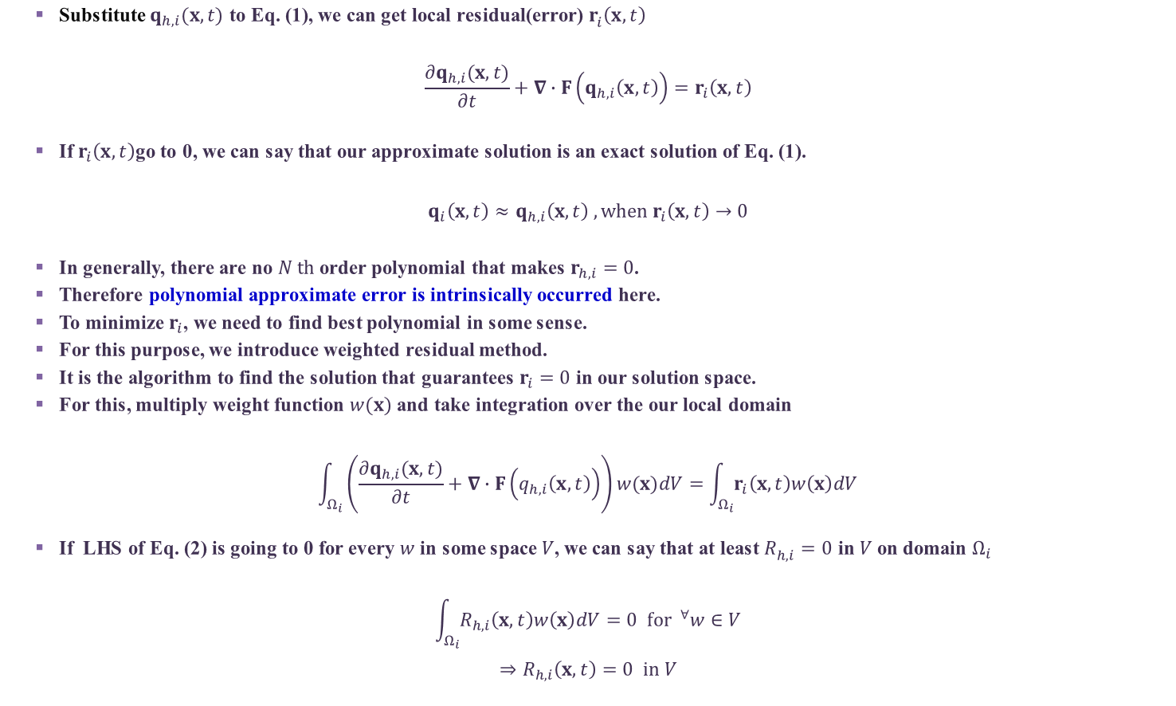
Discontinuous Galerkin Method
Substitute $q_{h,i}(x,t)$ to Eq. (1), we can get local residual(error) $r_{i}^{ }\left(x,t\right)$
$$\frac{∂q_{h,i}(x,t)}{∂t}+∇∙F\left(q_{h,i}\left(x,t\right)\right)=r_{i}\left(x,t\right)$$
If $r_{i}\left(x,t\right)$go to 0, we can say that our approximate solution is an exact solution of Eq. (1).
$$q_{i}\left(x,t\right)≈q_{h,i}\left(x,t\right) , when r_{i}\left(x,t\right)→0$$
In generally, there are no $N th$ order polynomial that makes $r_{h,i}=0$.
Therefore polynomial approximate error is intrinsically occurred here.
To minimize $r_{i}$, we need to find best polynomial in some sense.
For this purpose, we introduce weighted residual method.
It is the algorithm to find the solution that guarantees $r_{i}=0$ in our solution space.
For this, multiply weight function $w(x)$ and take integration over the our local domain
$$\int_{Ω_{i}}{\left(\frac{∂q_{h,i}(x,t)}{∂t}+∇∙F\left(q_{h,i}\left(x,t\right)\right)\right)w(x)dV}=\int_{Ω_{i}}{r_{i}\left(x,t\right)w\left(x\right)dV}$$
If LHS of Eq. (2) is going to 0 for every $w$ in some space $V$, we can say that at least $R_{h,i}^{ }=0$ in $V$ on domain $Ω_{i}$
$$\int_{Ω_{i}}{R_{h,i}\left(x,t\right)w\left(x\right)dV}=0 for ^{∀}w∈V$$
$$⇒R_{h,i}\left(x,t\right)=0 in V$$
(2)

